Slide 1
S3 Biology
Broxburn Academy

Slide 2
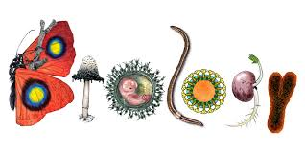
Biology is…
The science of the study of living organisms
It covers things like physiology, anatomy, behaviour, origin, and distribution of organisms.

Slide 3
Course contents
Cell structure
Respiration
Enzymes
The nervous system
Reproduction
Photosynthesis
Ecosystems
Evolution

Slide 4
S3 Biology
The course introduces some of the main concepts in Biology
This is background for the National 4 and 5 courses
You will be regularly assessed to ensure you are understanding
Assessments include the topic you’ve just covered and questions from earlier topics
Homework will be issued every two weeks and will include knowledge and problem solving

Slide 5
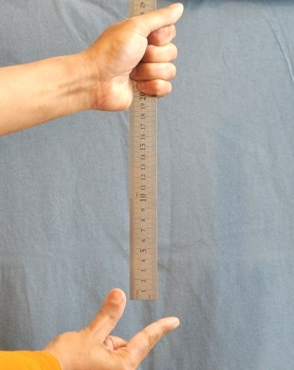
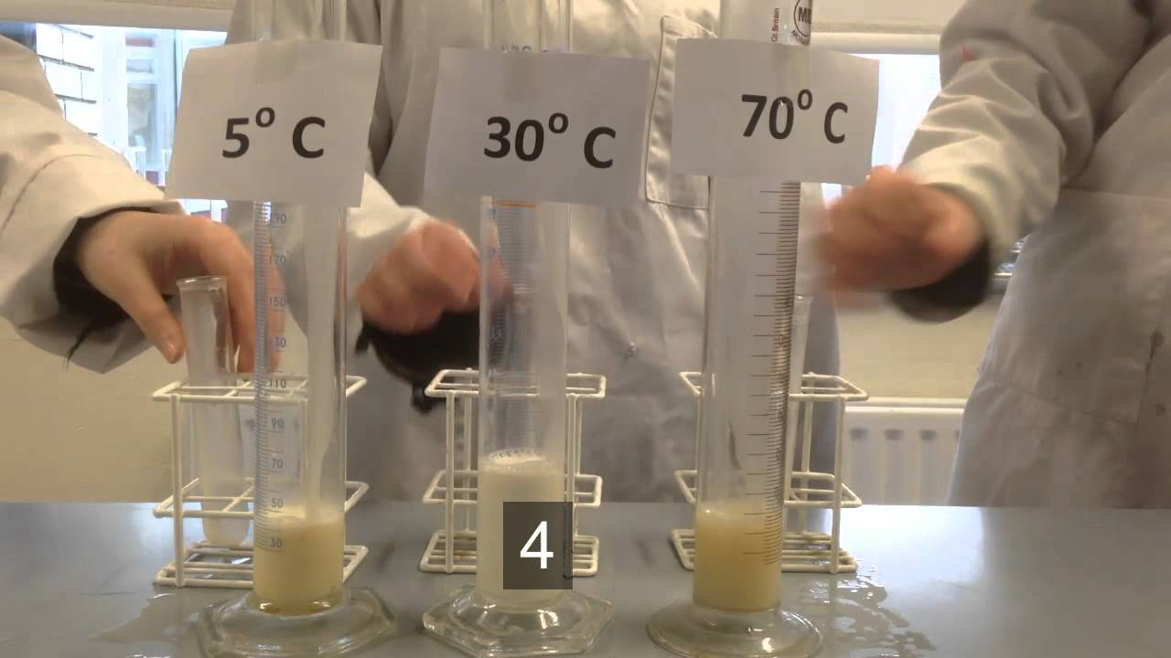
Skills in Biology
Numeracy
Designing investigations
Percentages
Averages
Ratios
Drawing graphs
Designing reliable, fair and valid experiments.
Literacy
Reading for understanding
Research
Reading graphs

Slide 6
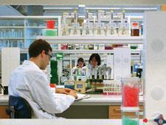
Careers in biology
Research scientist.
Pharmacologist.
Biologist.
Ecologist.
Nature conservation officer.
Biotechnologist.
Forensic scientist.
Teacher
And many, many more

Slide 7
S3 Chemistry
Broxburn Academy

Slide 8
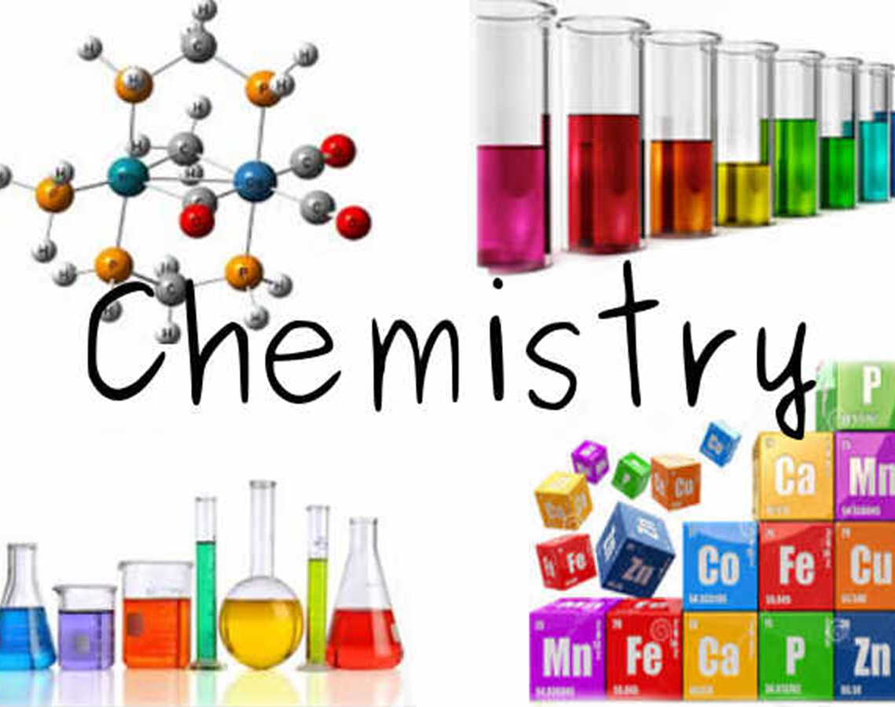
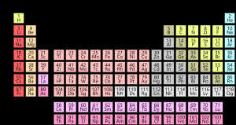
Chemistry is…
The science of elements and compounds made of atoms, molecules and ions
Chemistry deals with the structure and properties of substances
It also looks at the way substances change and react with other substances

Slide 9
Course contents
Atomic Structure and Bonding
Metals
Fuels
Rates of reaction
Polymers
Problem solving skills

Slide 10
S3 Chemistry
The course introduces some of the main concepts in Chemistry
This is background for the National 4 and 5 courses
At the end of the first three topics you take a rotation test
After the test we move onto covering topics from the National 4/5 courses
Homework will be issued every two weeks and will include knowledge and problem solving

Slide 11
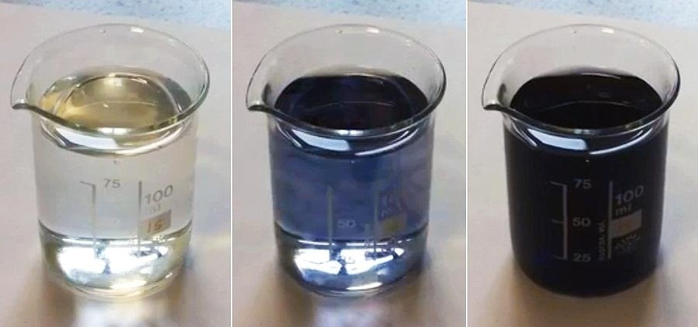
Skills in Chemistry
Numeracy
Designing investigations
Percentages
Averages
Ratios
Drawing graphs
Using equations
Designing reliable, fair and valid experiments
Using chemicals and equipment safely
Literacy
Reading for understanding
Research
Reading graphs

Slide 12
Careers in chemistry
Engineering
Medicine and vet medicine or nursing
Pharmacy
Forensic science
Biochemical science
Teaching
Research
And many, many more

Slide 13
S3 Physics
Broxburn Academy

Slide 14
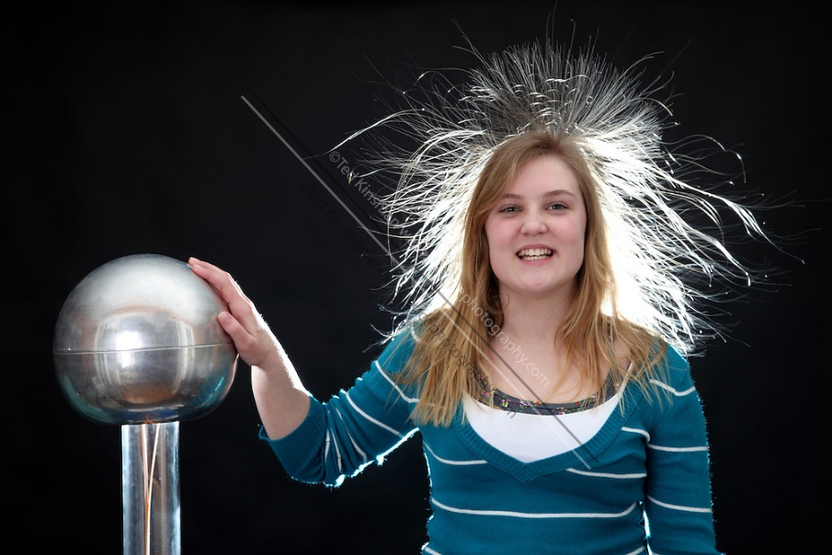
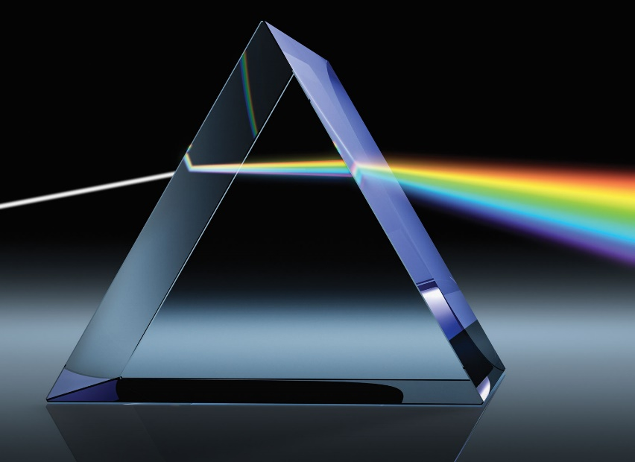
Physics is…
The science of the study of matter and energy
It covers things like mechanics, heat, light and other radiation, sound, electricity, magnetism, and the structure of atoms.

Slide 15
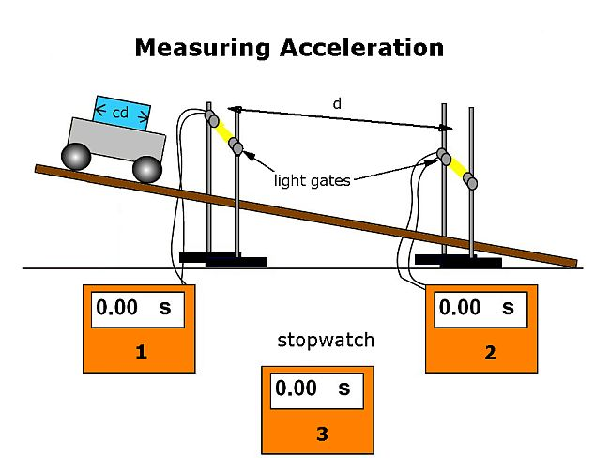
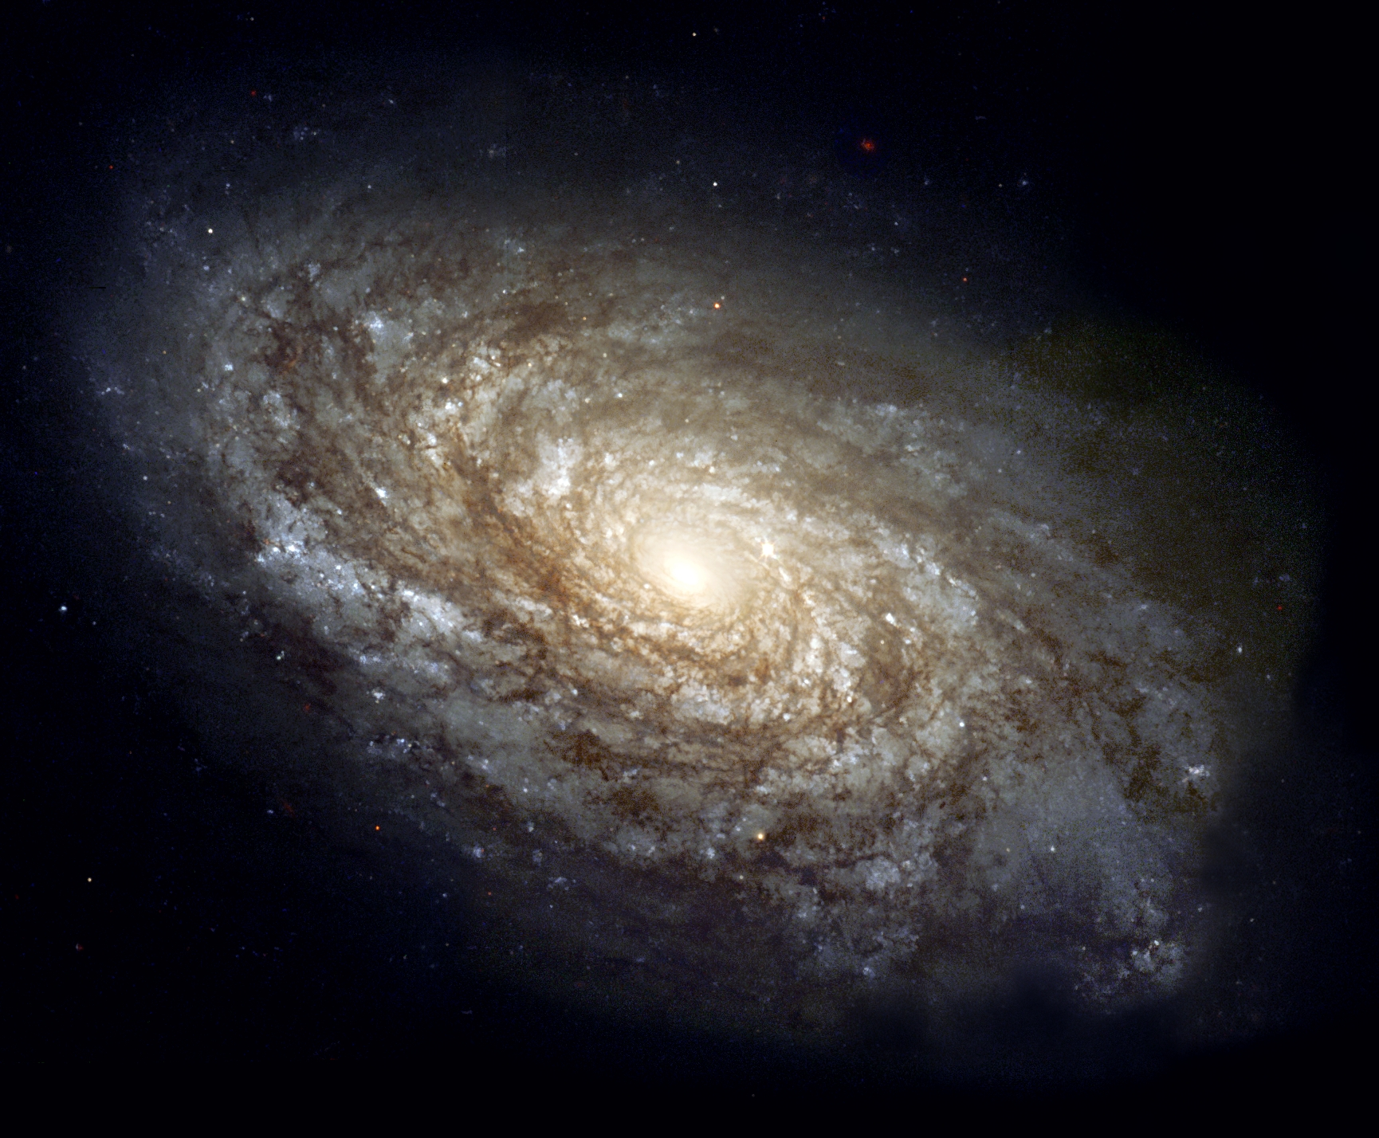
Course contents
Speed & acceleration
The Solar System
Stars & The Universe
Waves & Light
Electricity
Satellites
Space Exploration
Electric Circuits

Slide 16
S3 Physics
The course introduces some of the main concepts in Physics
This is background for the National 4 and 5 courses
You will be regularly assessed to ensure you are understanding
Assessments include the topic you’ve just covered and questions from earlier topics

Slide 17
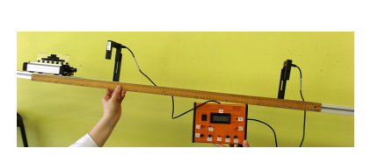
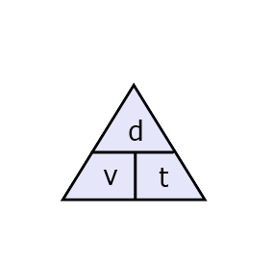
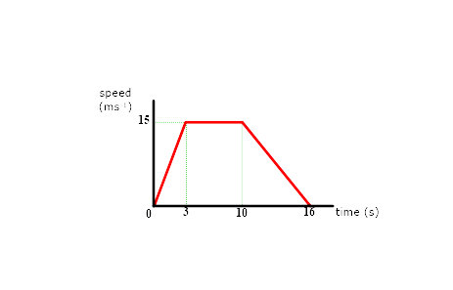
Skills in Physics
Carrying out experiments
Using equations
distance = speed x time
weight = mass x gravity
Drawing and using graphs

Slide 18
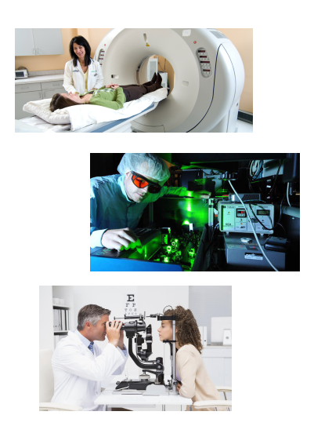
Careers in Physics
Engineer
Radiologist
Electrician
Astronomer
Laser physicist
Electronics
Optician
Sound Engineer
Weather Forecaster
Renewable Energy
Science journalist
Particle physicist
Architect

