Slide 1





TOGETHER WE WILL SUCCEED
Welcome to …
Broxburn Academy

Slide 2
TOGETHER WE WILL SUCCEED
Introducing the Senior Management Team
and Recent News from Broxburn Academy
Mr Reid
Headteacher

Slide 3
TOGETHER WE WILL SUCCEED
Introducing the Senior Management Team
Mrs Adam
Depute Headteacher
Broad General Education [S1, S2 and S3]

Slide 4
TOGETHER WE WILL SUCCEED
Introducing the Senior Management Team
Mrs Rowland
Depute Headteacher
Senior Phase [S4 and S5]

Slide 5
TOGETHER WE WILL SUCCEED
Introducing the Senior Management Team
Mrs Russell
Depute Headteacher
Pupil Support [S6]

Slide 6
TOGETHER WE WILL SUCCEED
Introducing the Senior Management Team
Mrs Churchill
Business Support Manager

Slide 7
TOGETHER WE WILL SUCCEED
Introducing the Extended Senior Management Team
Mr Gray
Principal Teacher Curriculum
Maths and PE

Slide 8
TOGETHER WE WILL SUCCEED
Introducing the Extended Senior Management Team
Mr Hill
Principal Teacher Curriculum
Science and computing

Slide 9
TOGETHER WE WILL SUCCEED
Introducing the Extended Senior Management Team
Mrs Keating
Principal Teacher Curriculum
Business education, craft, design and technology, home economics and music

Slide 10
TOGETHER WE WILL SUCCEED
Introducing the Extended Senior Management Team
Mrs McKenzie
Principal Teacher Curriculum
Religious, moral and philosophical studies, and social subjects

Slide 11
TOGETHER WE WILL SUCCEED
Introducing the Extended Senior Management Team
Mrs Orrock
Principal Teacher Curriculum
English, modern languages and drama

Slide 12
TOGETHER WE WILL SUCCEED
Introducing the Extended Senior Management Team
Support
Miss McGregor
Principal Teacher Curriculum
Pupil Support

Slide 13
TOGETHER WE WILL SUCCEED
Introducing the Extended Senior Management Team
Support
Mr Thomson
Principal Teacher Curriculum
Additional Support Needs

Slide 14
TOGETHER WE WILL SUCCEED
Introducing the Extended Senior Management Team
Support
Mr Shade
Principal Teacher Curriculum
Additional Support Needs

Slide 15
TOGETHER WE WILL SUCCEED
Introducing the Extended Senior Management Team
Support
Miss Oliver
Pupil Support Manager

Slide 16

TOGETHER WE WILL SUCCEED
The House System – Mrs Russell

Slide 17
TOGETHER WE WILL SUCCEED
Introducing the Heads of House
Almondell – Mr Daly
[Surnames A-D]

Slide 18
TOGETHER WE WILL SUCCEED
Introducing the Heads of House
Buchan – Mrs Robertson
[Surnames E-L]

Slide 19
TOGETHER WE WILL SUCCEED
Introducing the Heads of House
Cardross – Mrs Scoular / Mr Baird
[Surnames M-Q]

Slide 20
TOGETHER WE WILL SUCCEED
Introducing the Heads of House
Strathbrock – Mrs Moonie
[Surnames R-Z]

Slide 21
TOGETHER WE WILL SUCCEED
Introducing the Pupil Support Workers
Mrs Cameron
Mrs Collins
Miss Lochrie
Mrs Merrit

Slide 22
TOGETHER WE WILL SUCCEED
What to do when your child is going to be absent:
Phone pupil support

Slide 23
TOGETHER WE WILL SUCCEED
What to do when you want to speak to
the head of house or guidance:
Phone pupil support or
the school office to make an appointment.

Slide 24
TOGETHER WE WILL SUCCEED
The School Day – Mrs Adam
Period 1 | 8.35 am to 9.25 am
Period 2 | 9.25 am to 10.15 am
Registration | 10.15 am to 10.25 am
Period 3 | 10.25 am to 11.15 am
Break | 11.15 am to 11.30 am
Period 4 | 11.30 am to 12.20 pm [end of day on Fridays]

Slide 25
TOGETHER WE WILL SUCCEED
The School Day
Period 5 | 12.20 pm to 1.10 pm
Lunch | 1.10 pm to 1.50 pm
Period 6 | 1.50 pm to 2.40 pm
Period 7 | 2.40 pm to 3.30 pm

Slide 26
TOGETHER WE WILL SUCCEED
The Broad General Education S1 to S3
S1 to S3:
  English,
  Mathematics
  Modern Languages (Spanish and French)
  Science

Slide 27
TOGETHER WE WILL SUCCEED
The Broad General Education S1 to S3
  Physical Education
  Religious and Moral Education
  Skills for Learning, Life and Work
  Personal and Social Education
  Social Subjects

Slide 28
TOGETHER WE WILL SUCCEED
The Broad General Education S1 to S3
S1 – home economics, business, drama, art, music and craft, design technology
Choices in February of S1: in addition these, computing, dance, uniformed services, and debating

Slide 29
TOGETHER WE WILL SUCCEED
Dress Code
School tie
White/Black shirt
Black trousers/black skirt
Plain black jumper/pullover
Black footwear
Blazer

Slide 30
TOGETHER WE WILL SUCCEED
Class Expectations
Arrive on time to classes
Be prepared for lessons (pen/pencil)
Water only in classes
Use of mobile phones/tablets – teachers’ discretion
No chewing gum

Slide 31
TOGETHER WE WILL SUCCEED
Additional Support Needs and Transition – Mr Shade
Individual education plans, profiles created
Shared with all staff in advance
Speak to Mr Shade or Mr Thomson about support.

Slide 32
TOGETHER WE WILL SUCCEED
Additional Support Needs and Transition
Strategies offered:
Reader, scribe, support in classes, ICT support, extra time
Base Time:
3 learning zones (small group/one to one)

Slide 33
TOGETHER WE WILL SUCCEED
Physical Education Participation
No Note Policy – Mr Gray
Pupil participation in every lesson
enjoyment and
opportunity for skill development.
Notes:
We do not accept notes from parents or carers excusing pupils from participation in all PE activities.
We expect that every pupil will bring their PE kit to school, change into their PE kit and then discuss what level of participation they can contribute with the class teacher at the start of the lesson.

Slide 34
TOGETHER WE WILL SUCCEED
Building Learning Power – Mr Hider
Notes:
We do not accept notes from parents or carers excusing pupils from participation in all PE activities.
We expect that every pupil will bring their PE kit to school, change into their PE kit and then discuss what level of participation they can contribute with the class teacher at the start of the lesson.
In particular there is no longer a group of pupils not participating with the potential to disrupt the learning of those who are.
Additionally many pupils who have not been able to fully participate have commented on how the have enjoyed participating in a different aspect, such as; refereeing, score keeping or evaluating others' performances.
We ask for your full support in this matter.

Slide 35
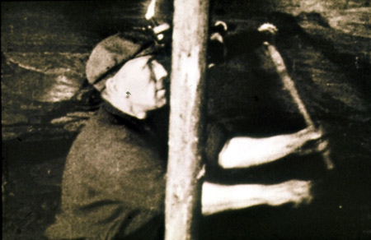

Slide 36

Pupils
Parents
School

Slide 37
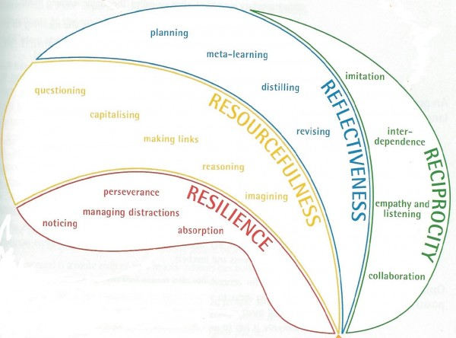
BUILDING LEARNING POWER

Slide 38



Parent/Carer Feedback
It was a useful tool to support my son in high school
I’ve got a better understanding of how school works now
The presenters were really enthusiastic and friendly
It was nice and relaxed
I would fully recommend the sessions to parents; they are very valuable, interesting and most of all will help your child’s education
I was a bit worried about going into the school, but everyone was so nice and helpful. I’m really glad I went.
Helps consistency between school and home

Slide 39
TOGETHER WE WILL SUCCEED
Show My Homework – Mrs Rowland
.
Notes:
We do not accept notes from parents or carers excusing pupils from participation in all PE activities.
We expect that every pupil will bring their PE kit to school, change into their PE kit and then discuss what level of participation they can contribute with the class teacher at the start of the lesson.

Slide 40

A Parent’s Guide to Show My Homework

Slide 41

What is Show My Homework?
A simple online solution for students and parents to view homework details and upcoming deadlines.
Mobile apps and notifications ensure you always know what homework your child has and when it’s due.

Slide 42
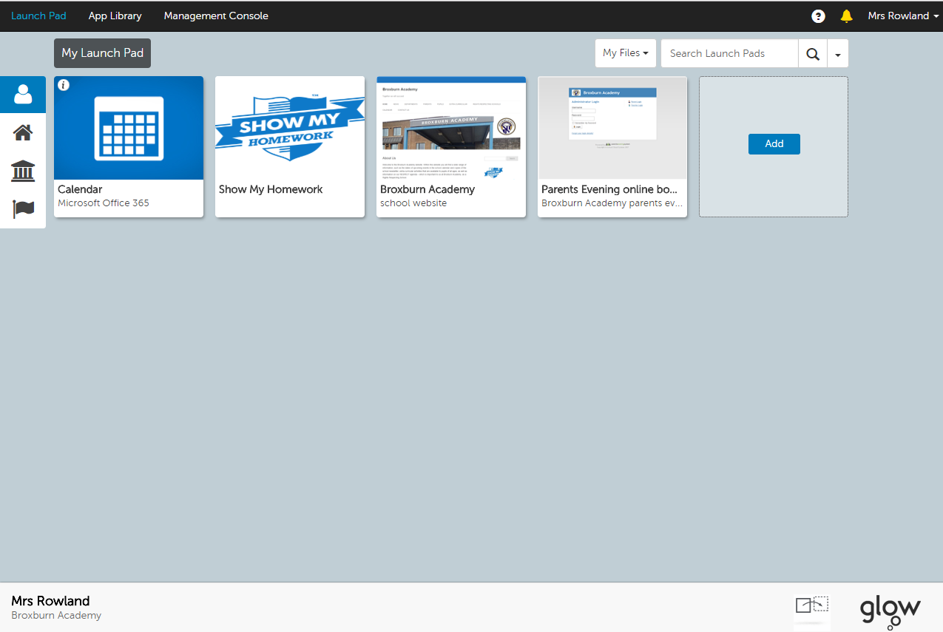
Where is Show My Homework?
A simple online solution for students and parents to view homework details and upcoming deadlines.
Mobile apps and notifications ensure you always know what homework your child has and when it’s due.

Slide 43
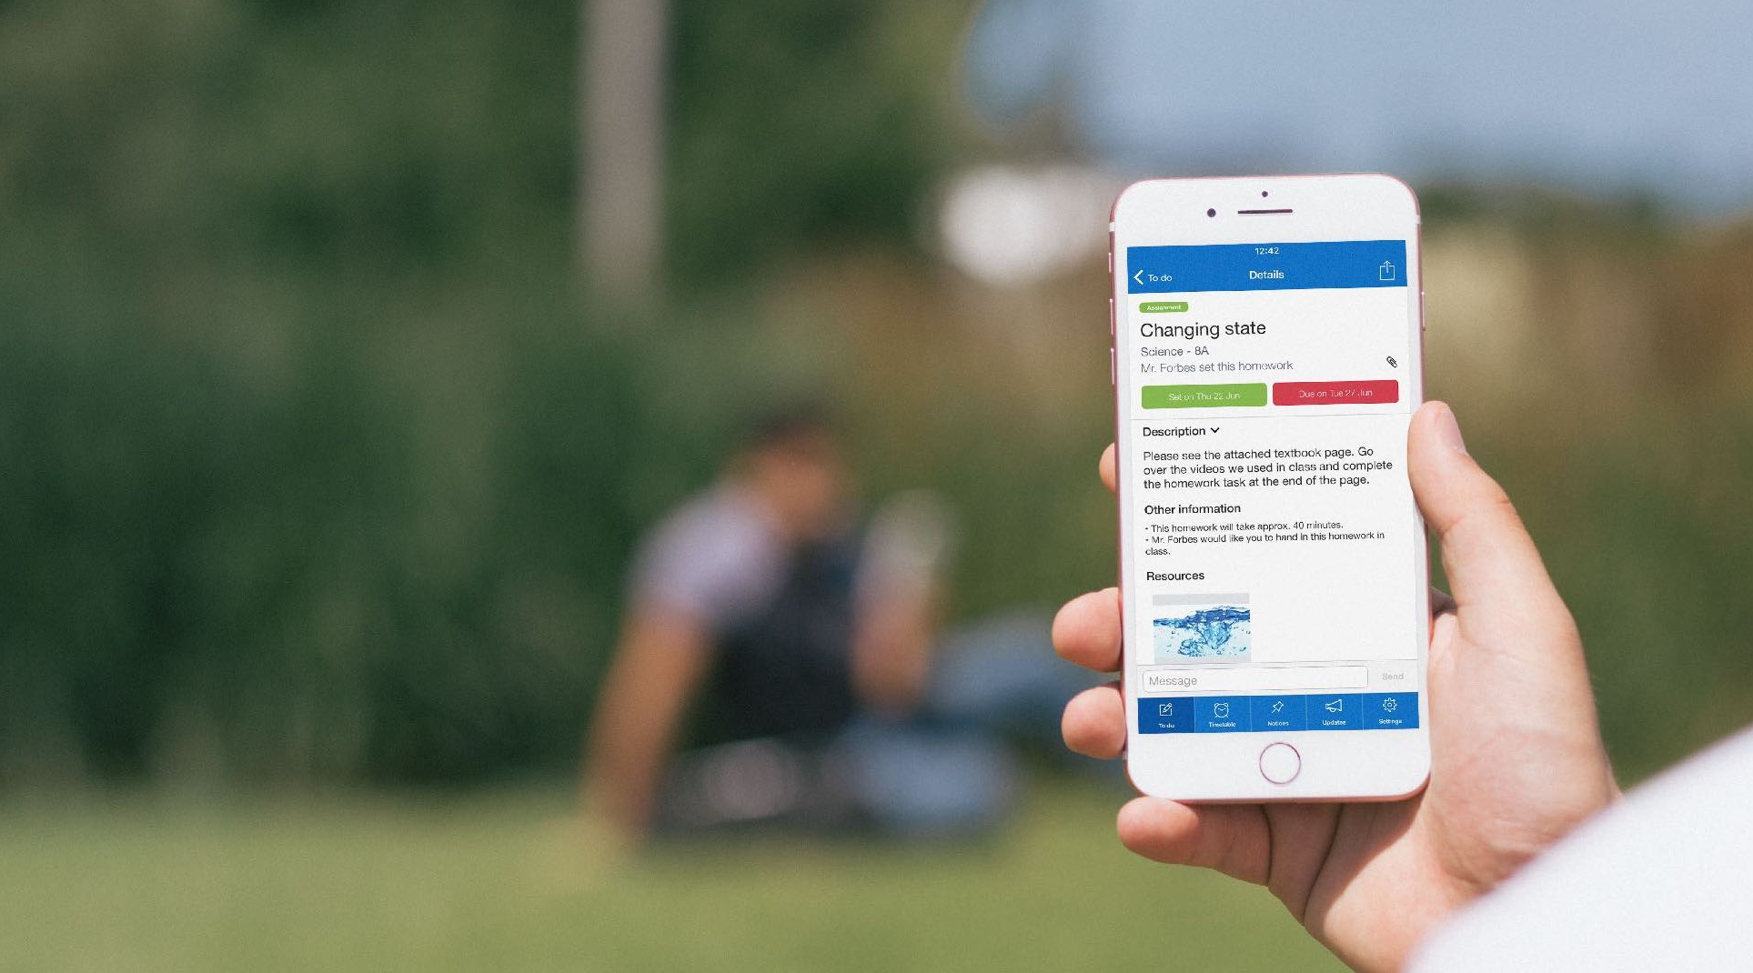
Homework Description
Here is a task’s title and description, issue and due dates and how it should be submitted.

Slide 44
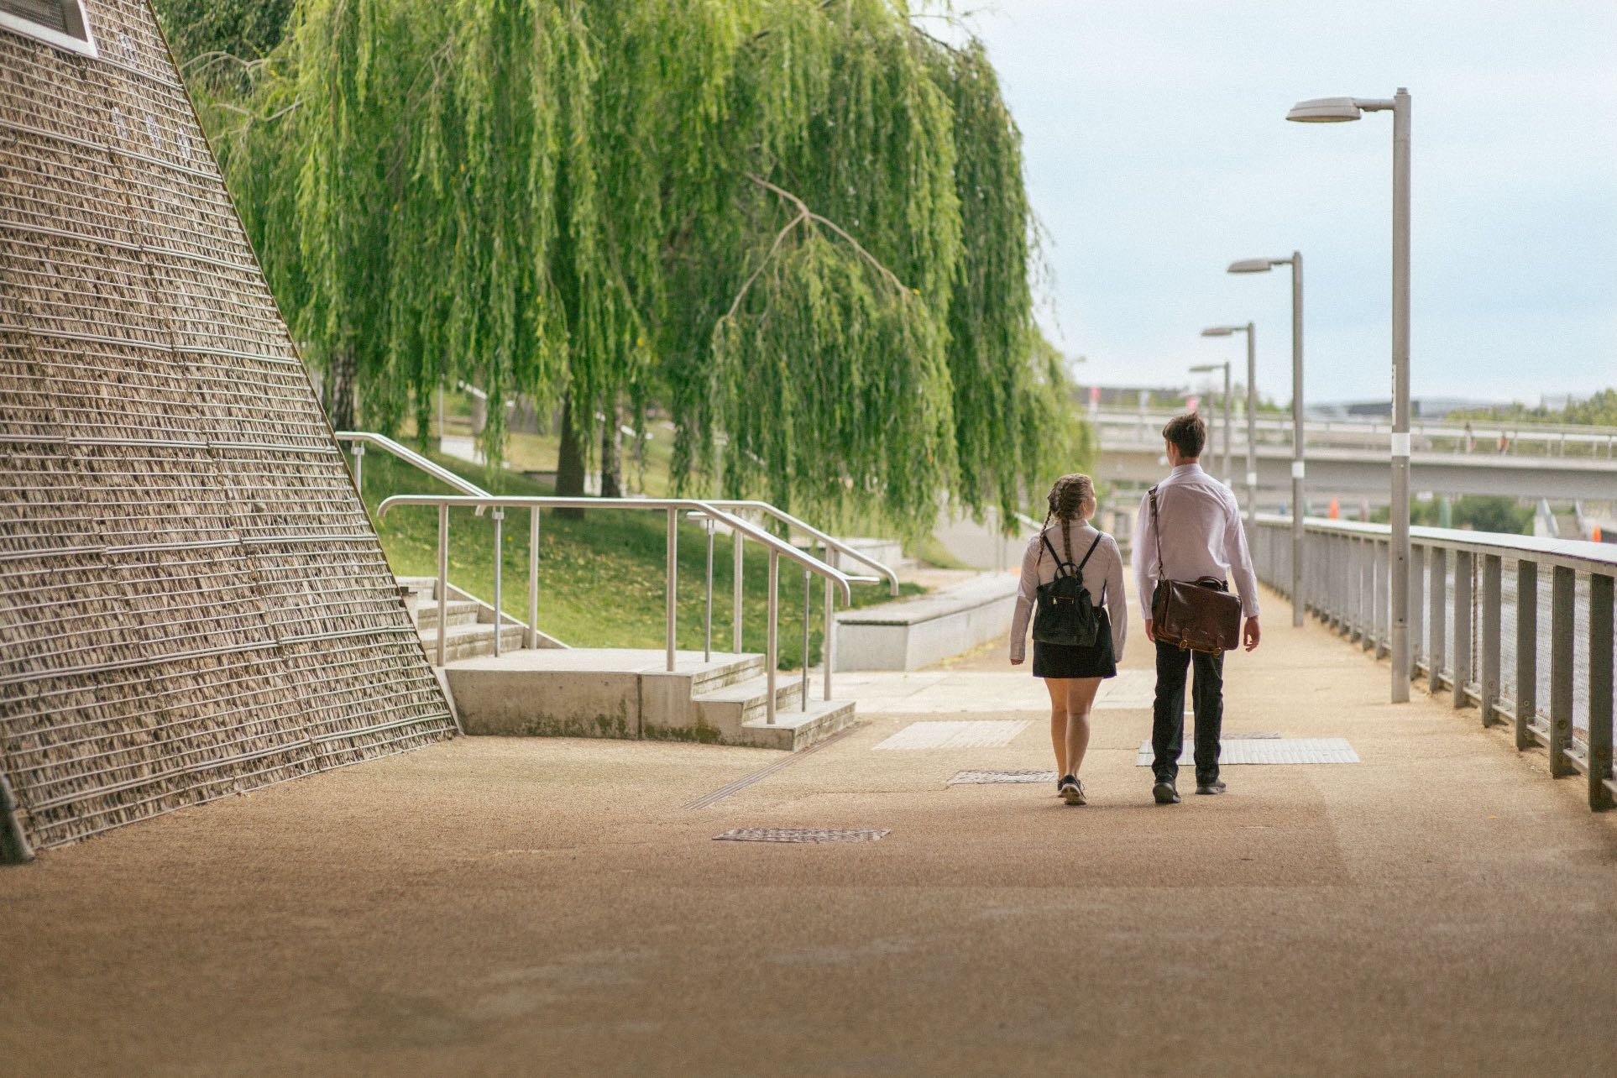
How Show My Homework can Help You
Get notifications straight to your phone
See when homework has been submitted and the grades awarded for it.
Visibility - See exactly how much homework has been set and when it’s due

Slide 45


Benefits for Students
Automatic notifications to remind you
More time to ask questions in class
Marking and feedback returned faster and in private
See all your homework at the click of a button
Free smartphone app – No more homework diaries!
Access to description and resources wherever they are
A personalised experience to help stay organised

Slide 46
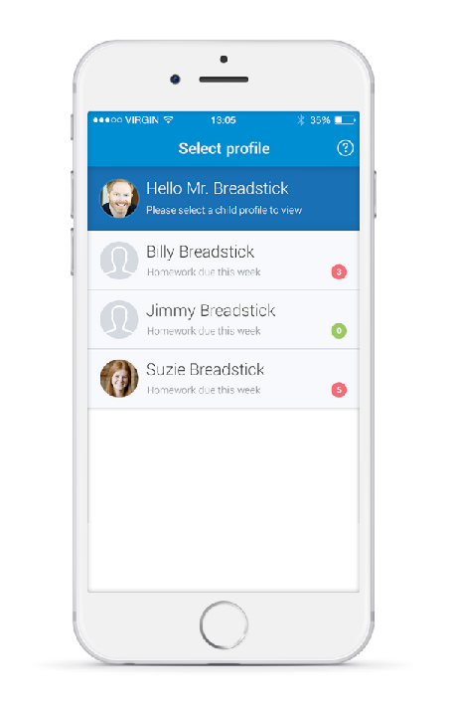

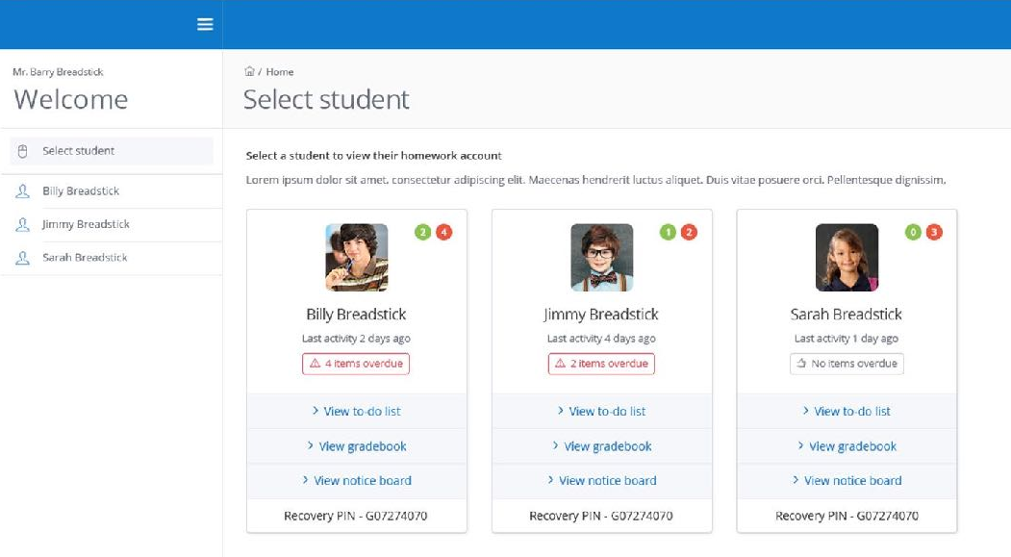
More Than One Child?
More than one child at the school? Don’t worry they’ll appear on the same page.

Slide 47
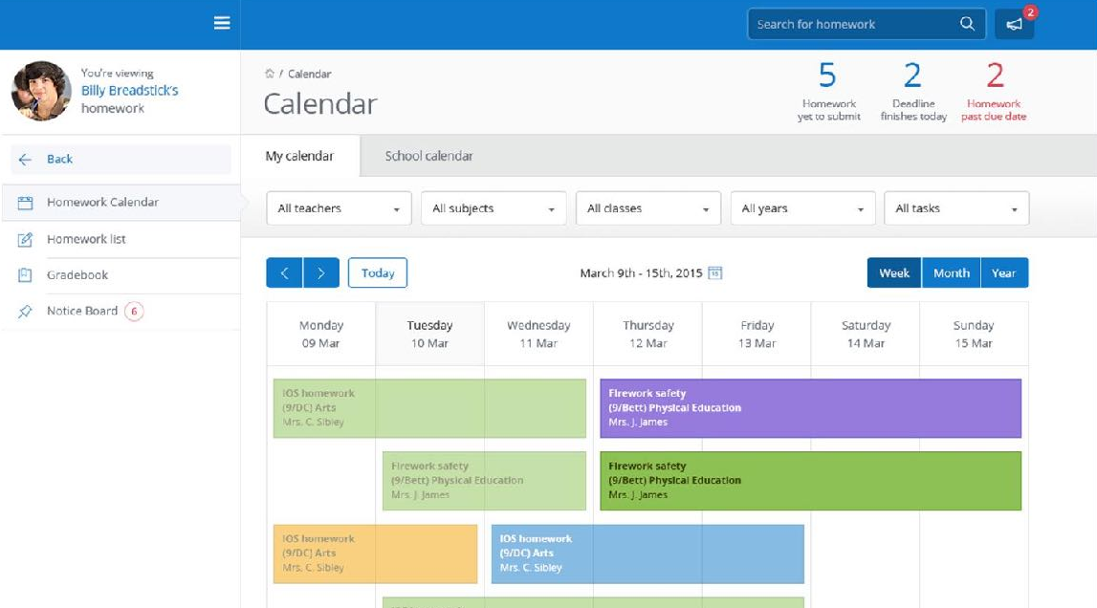
The Homework Calendar
Homework appears as a block, stretching from the issue date to the due date.

Slide 48
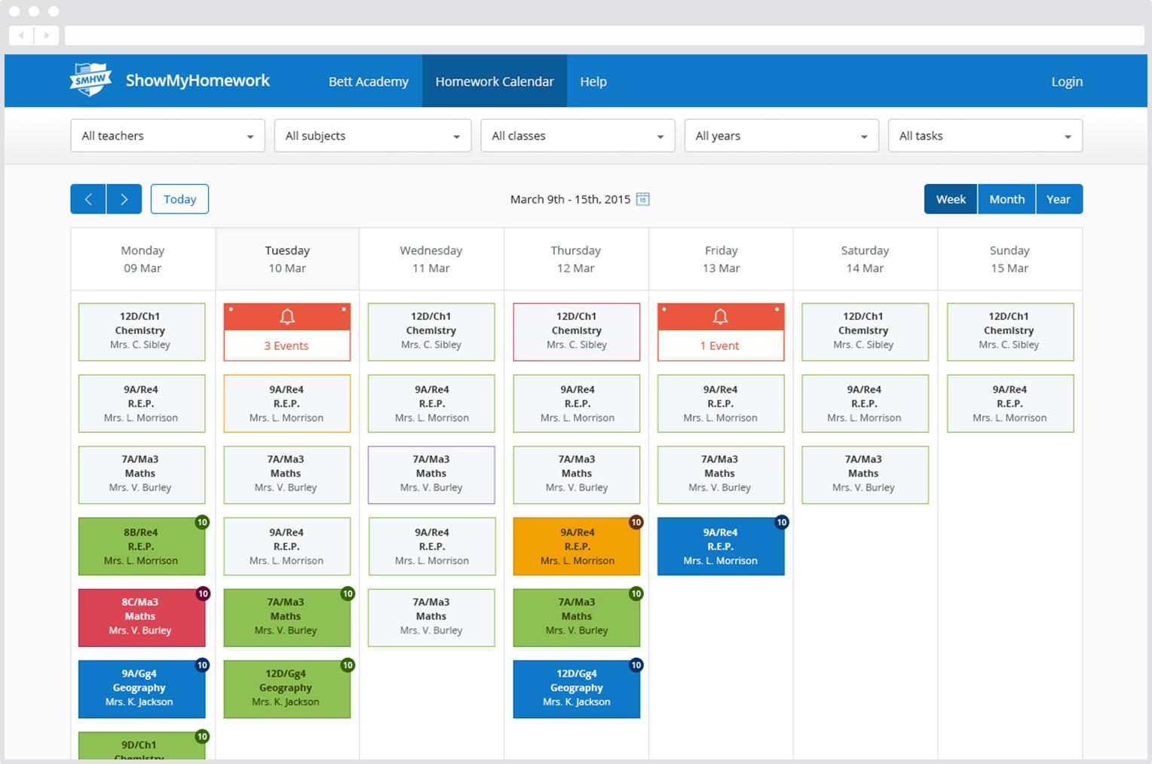
The No-login Backup!
You can view the school homework calendar without even logging in.
Submission types
Submitted
Submitted late
Absent
Resubmission
Not submitted

Slide 49
TOGETHER WE WILL SUCCEED
Achievers Camp – Mr Thomson
.
Notes:
We do not accept notes from parents or carers excusing pupils from participation in all PE activities.
We expect that every pupil will bring their PE kit to school, change into their PE kit and then discuss what level of participation they can contribute with the class teacher at the start of the lesson.

Slide 50
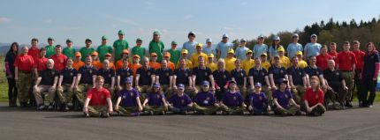

TOGETHER WE WILL SUCCEED
BROXBURN ACADEMY &
LOTHIAN & BORDER ARMY CADETS
.
ACHIEVER WEEKEND
FRI 10TH TO SUN 12TH OF AUGUST
Notes:
We do not accept notes from parents or carers excusing pupils from participation in all PE activities.
We expect that every pupil will bring their PE kit to school, change into their PE kit and then discuss what level of participation they can contribute with the class teacher at the start of the lesson.

Slide 51
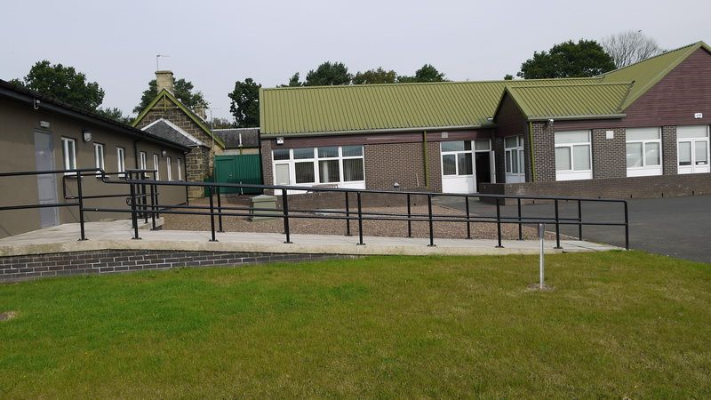
TOGETHER WE WILL SUCCEED
AT DRUMSHORELAND ARMY CADET TRAINING CENTRE
.
Notes:
We do not accept notes from parents or carers excusing pupils from participation in all PE activities.
We expect that every pupil will bring their PE kit to school, change into their PE kit and then discuss what level of participation they can contribute with the class teacher at the start of the lesson.

Slide 52
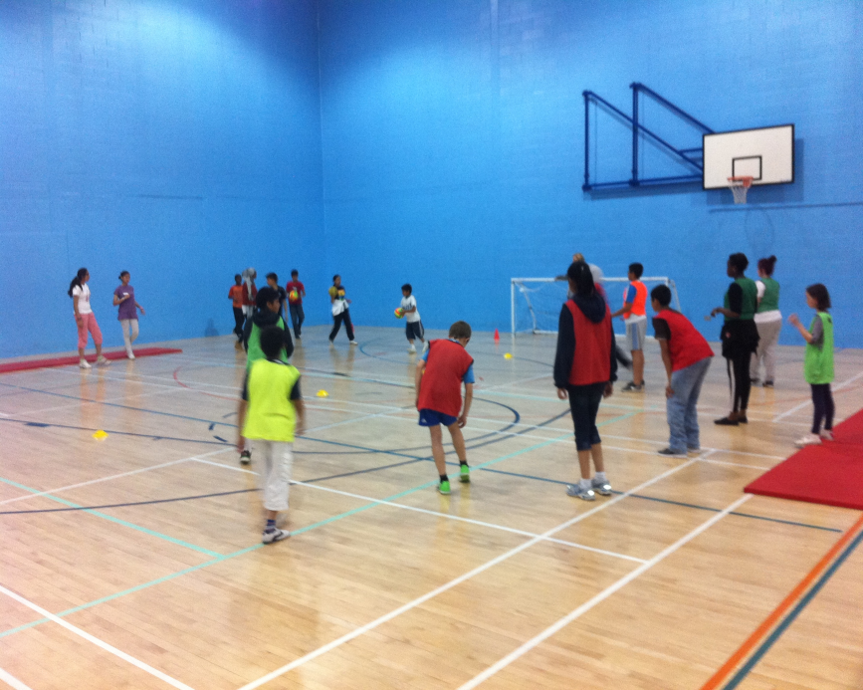
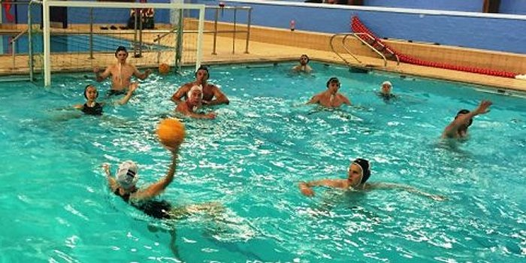
TOGETHER WE WILL SUCCEED
.
FOOTBALL, HOCKEY, ATHLETICS, SWIMMING AND MORE
Notes:
We do not accept notes from parents or carers excusing pupils from participation in all PE activities.
We expect that every pupil will bring their PE kit to school, change into their PE kit and then discuss what level of participation they can contribute with the class teacher at the start of the lesson.

Slide 53
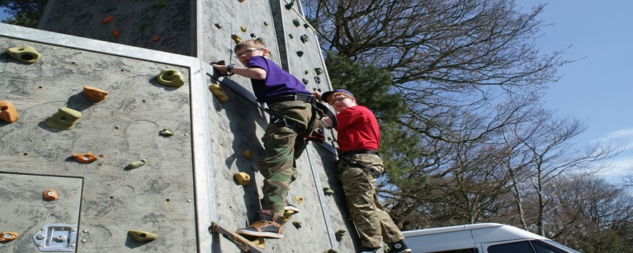
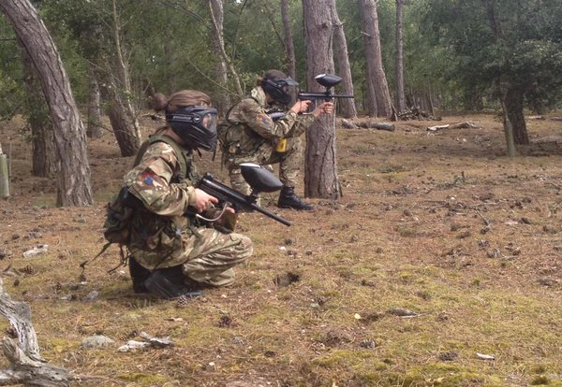
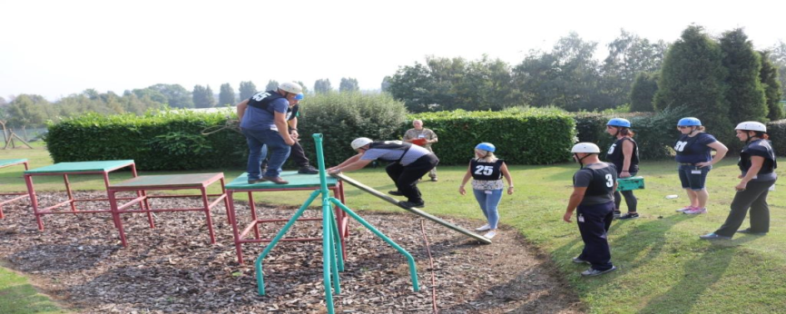
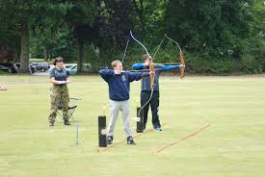
TOGETHER WE WILL SUCCEED
ADVENTURE TRAINING
.
Notes:
We do not accept notes from parents or carers excusing pupils from participation in all PE activities.
We expect that every pupil will bring their PE kit to school, change into their PE kit and then discuss what level of participation they can contribute with the class teacher at the start of the lesson.

Slide 54

TOGETHER WE WILL SUCCEED
TEN PIN BOWLING
.
Notes:
We do not accept notes from parents or carers excusing pupils from participation in all PE activities.
We expect that every pupil will bring their PE kit to school, change into their PE kit and then discuss what level of participation they can contribute with the class teacher at the start of the lesson.

Slide 55
TOGETHER WE WILL SUCCEED
. COST IS JUST £50
TO BE PAID BY THE END OF THE SCHOOL YEAR
THERE ARE ONLY 50 PLACES
FIRST COME FIRST SERVED
FOR MORE INFORMATION CONTACT
MR THOMSON AT BROXBURN AC 01506 282300
Notes:
We do not accept notes from parents or carers excusing pupils from participation in all PE activities.
We expect that every pupil will bring their PE kit to school, change into their PE kit and then discuss what level of participation they can contribute with the class teacher at the start of the lesson.

Slide 56
TOGETHER WE WILL SUCCEED
Broxburn Academy Parent Council
Sharon McDowall
.
Notes:
We do not accept notes from parents or carers excusing pupils from participation in all PE activities.
We expect that every pupil will bring their PE kit to school, change into their PE kit and then discuss what level of participation they can contribute with the class teacher at the start of the lesson.

Slide 57
TOGETHER WE WILL SUCCEED
Closing Remarks – Mr Reid
.
Notes:
We do not accept notes from parents or carers excusing pupils from participation in all PE activities.
We expect that every pupil will bring their PE kit to school, change into their PE kit and then discuss what level of participation they can contribute with the class teacher at the start of the lesson.

